Slide 1
Project Description

Slide 2
user story
Providing an excellent user experience to the customers.
The e-commerce website should be easy to navigate, visually appealing, and offer clear and detailed product information.
Having a secure payment system to ensure the customer's confidential information is safe.
Having a reliable and efficient shipping and delivery system to ensure the products arrive in a timely manner.
Customer support should be readily available to assist customers with any questions or issues they may have.
Providing an exceptional user experience will help to build customer loyalty and increase sales, making it the most important aspect of an e-commerce website.

Slide 3
Login/sign up
Search product
Add/remove to cart
Buy product
Login
Manage product
Manage all orders
Customer
Admin

Slide 4
UML Diagram
Login
Search product
Manage product
Customer
Admin
Add/Remove to cart
Manage all orders
Buy product

Slide 5
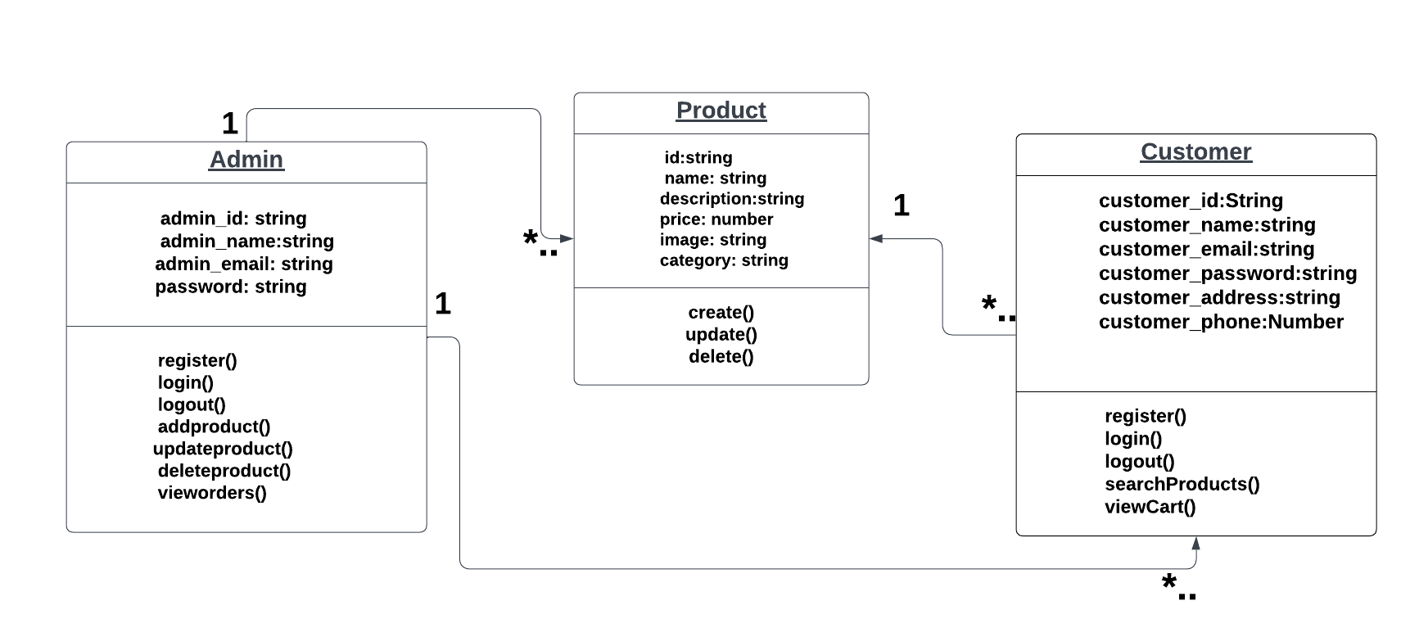
UML Class Diagram

